Slide 1
mRNA vaccine production
By,
Anirudh Veliyur(20CHE191)
Shauryaraj Jilkar(20CHE172)

Slide 2
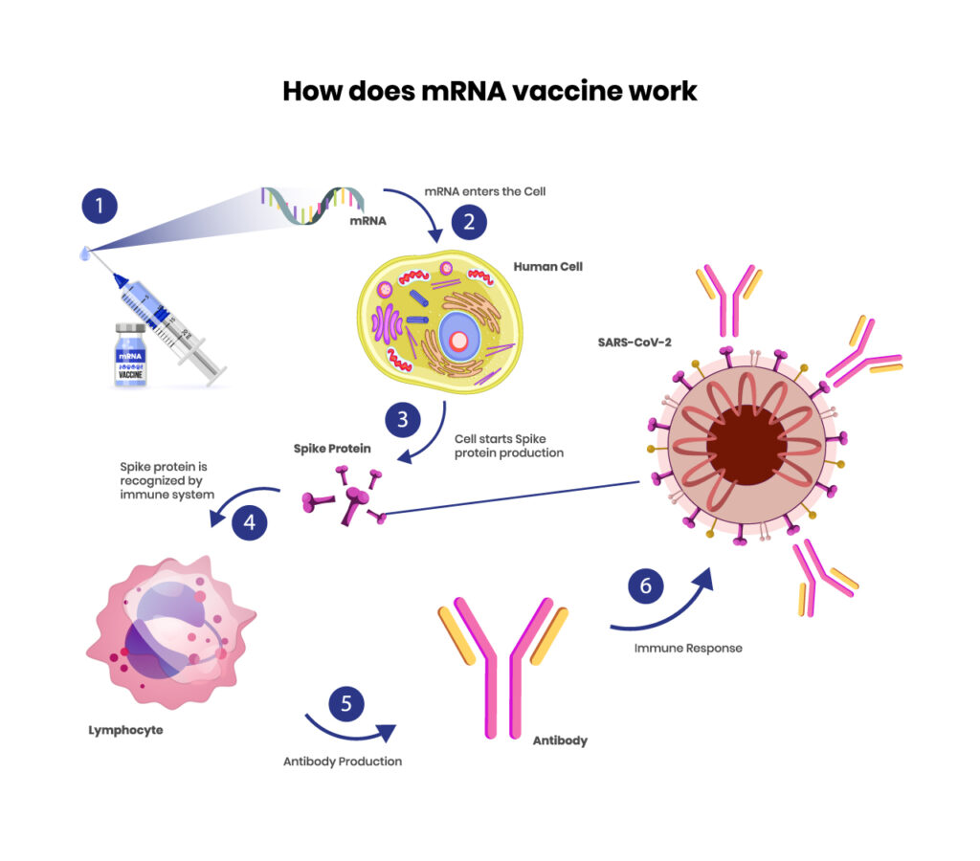
Principle

Slide 3
Sequence of operations in the manufacturing process
DNA Sequencing
Plasmid Insertion
Transcription by RNA polymerase
Protection in lipid bilayer
Purification by chromatography or tangential flow filtration
Delivery

Slide 4

Description of the manufacturing process
DNA Sequencing
Production of mRNA-based therapeutics and vaccines typically or commonly begins with a pDNA template that contains a DNA-dependent RNA polymerase promoter and the corresponding sequence for the mRNA construct.

Slide 5
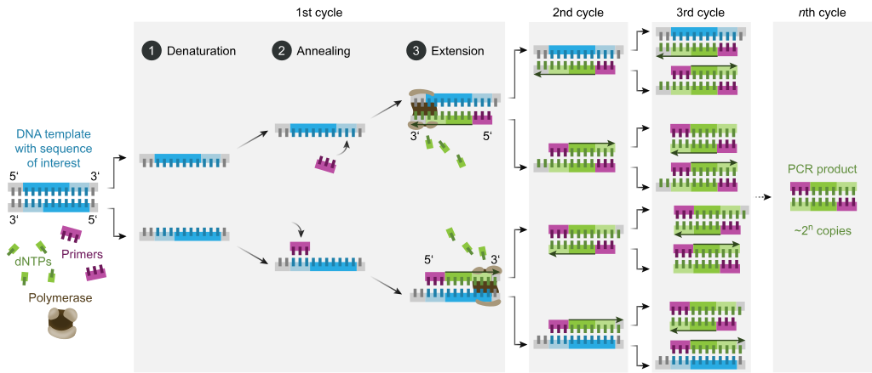
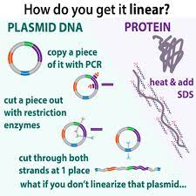
2) Plasmid insertion
pDNA Amplification
Linearization of pDNA

Slide 6
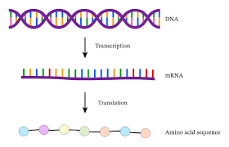
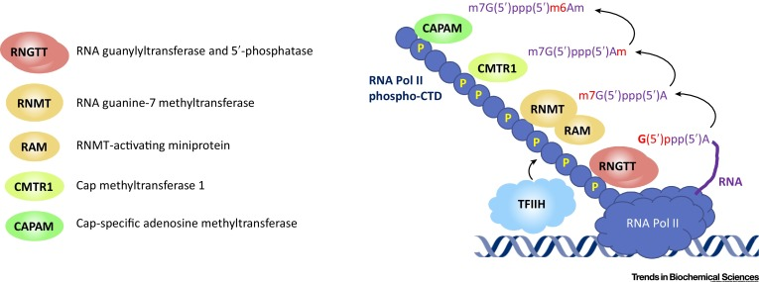
3) Transcription by RNA polymerase
In-vitro transcription
Enzymatic capping

Slide 7
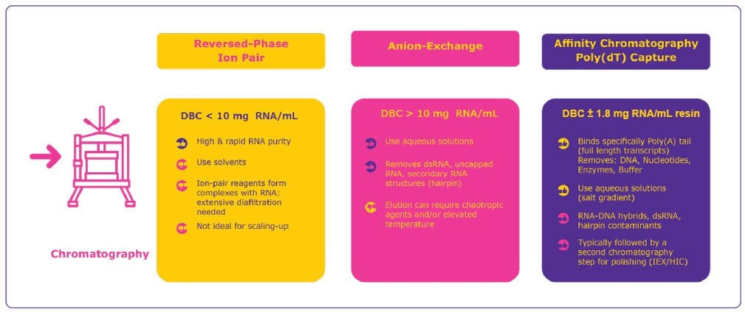
4) Purification of mRNA

Slide 8
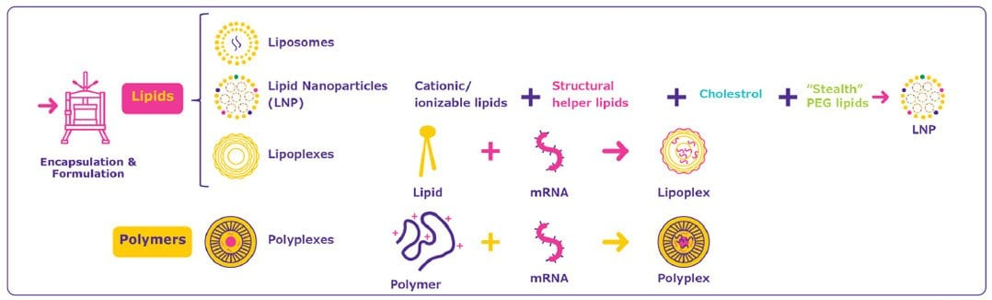
5) Protection in bilipid layer & delivery

Slide 9
Enzymatic data from Michaelis-Menten Plot
Data set 1
[NTP]tot, μM | [Enz]tot, μM | Velocity, μM·∙min-­‐1 | [NTP]/Vel
0.02 | 0.04 | 0.61 | 0.032787
0.04 | 0.04 | 1.03 | 0.038835
0.06 | 0.04 | 1.15 | 0.052174
0.08 | 0.04 | 1.25 | 0.064
0.12 | 0.04 | 1.23 | 0.097561
0.16 | 0.04 | 1.34 | 0.119403
Vmax | 1.529754
Km | 0.023252
Kcat | 38.24384

Slide 10
Enzymatic data from Michaelis-Menten Plot
Data set 2
[NTP]tot, μM | [Enz]tot, μM | Velocity, μM·∙min-­‐1 | [NTP]/Vel
0.02 | 0.08 | 0.67 | 0.029851
0.04 | 0.08 | 1.31 | 0.030534
0.06 | 0.08 | 1.9 | 0.031579
0.08 | 0.08 | 2.25 | 0.035556
0.12 | 0.08 | 2.49 | 0.048193
0.16 | 0.08 | 2.83 | 0.056537
Vmax | 4.844961
Km | 0.107558
Kcat | 60.56202

Slide 11
Optimum conditions
Temp range:- 38 - 42 °C
pH range:- 7.8 - 8.2
Mg²⁺ conc :- 8x10⁻³ M
Mn²⁺ conc :- 2x10⁻³ M

Slide 12
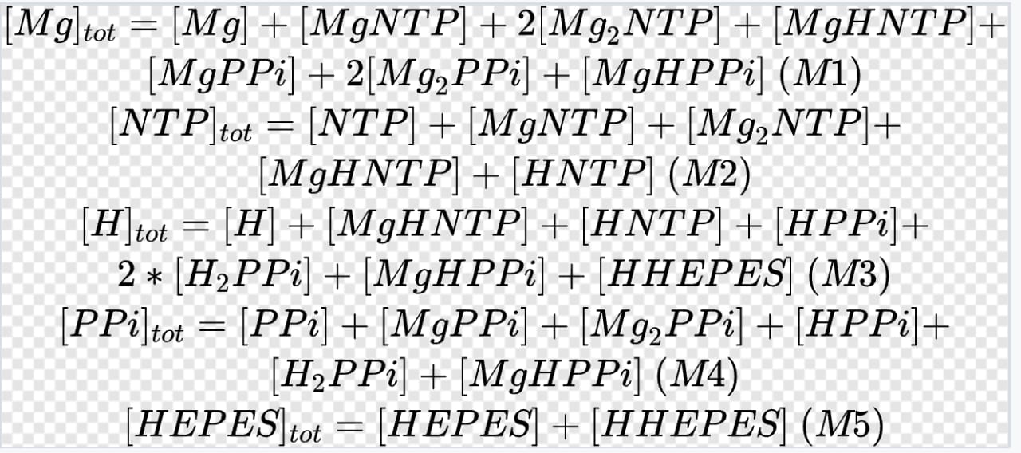
Mass Balance

Slide 13
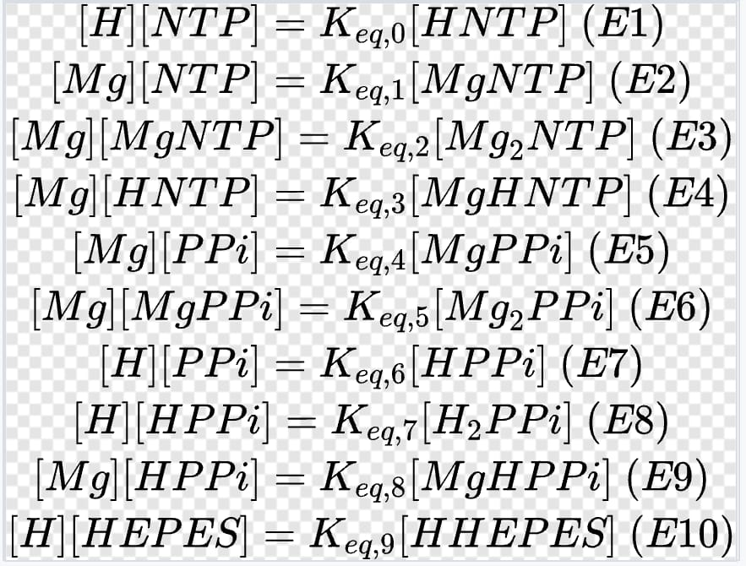
Equilibrium constraints

Slide 14
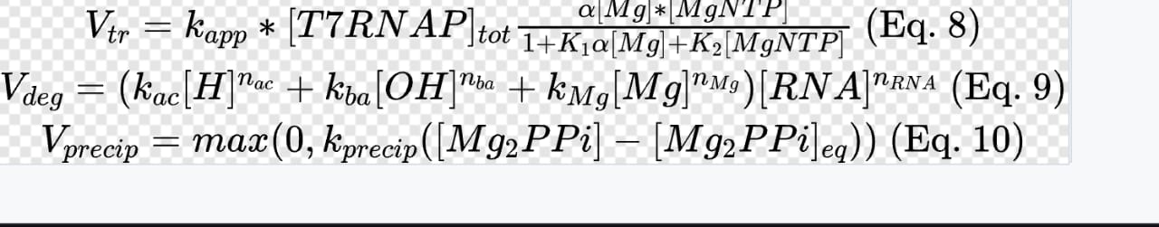
Kinetic expressions

Slide 15
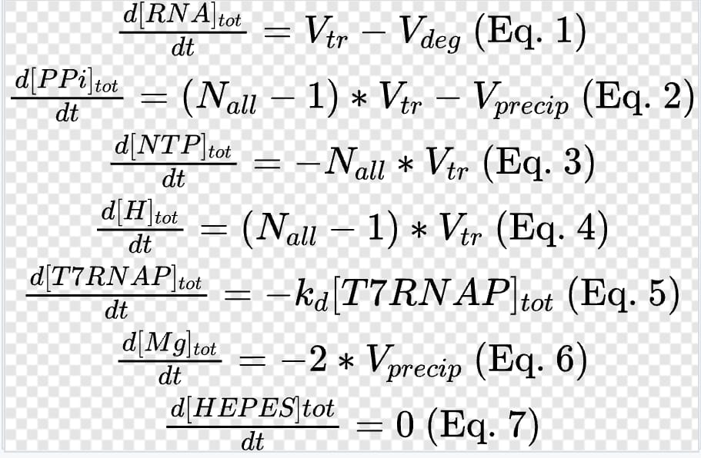
Differential equations

Slide 16
Process Conditions
1) Preparation of pDNA and production
Temperature:- 37°C
PCR amplification
Cell disruption through alkaline lysis at pH 12
pDNA precipitation with high-salt buffer (sodium or potassium acetate at concentration of 0.7 M–3.0 M and pH ~5–7.5, with/without 0.8–1.5% CaCl2) in the presence of a detergent (1% SDS)

Slide 17
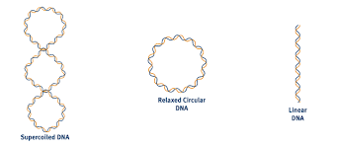
2) Linearization of pDNA
pDNA + restriction enzyme in a reaction buffer and incubation at 37 °C for 4 hours.
Reaction can be stopped by addition of EDTA or heat inactivation at 65 °C.
Tangential flow filtration and chromatography are then performed to remove impurities like restriction enzyme, BSA, DNA fragments, endotoxins.

Slide 18
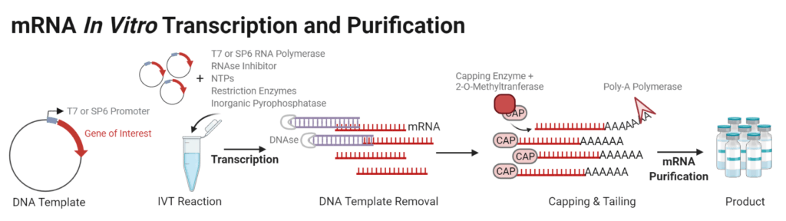
3) In-vitro transcription
DNA template at 10-70 nM
NTPs at 0.5-10 mM
T7 RNA polymerase at 1000-12000 U/mL
Magnesium at 12-60 mM
Buffer (HEPES or Tris) at a pH of 7-8.5
Pyrophosphatase at 1 U/mL
In-vitro transcription reaction is allowed to proceed, for example, under constant mixing at 37°C for 4 hours.

Slide 19
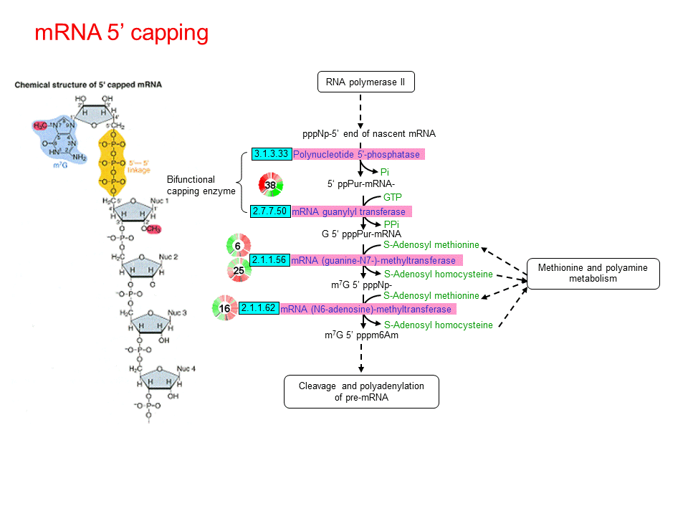
4) Capping of the RNA
S-adenosylmethione chloride*2HCl is dissolved at 20mM in 5mM HC1 10/90 v/v% ethanol/ water as a prepared stock.
The final IX buffer conditions consist of the following: 50mM Tris HCl pH 8, 5mM KC1, 1mM MgC12, and 1mM dithiothreitol.
The reaction is run under constant mixing at 37°C for 2 hours.

Slide 20
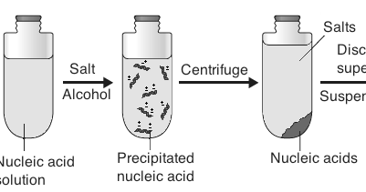
5) Purification and Concentration of product mRNA
Ethanol precipitation is carried out, most salts and small organic molecules are soluble in 70% ethanol.
Lithium chloride is used for precipitation of RNA as it can effectively precipitate RNA selectively and not DNA, carbohydrates and proteins.
Stock concentration of LiCl is 8M and working concentration required is 0.8M.

Slide 21
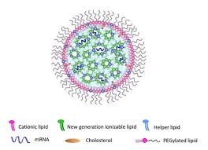
6) LNP Delivery
Modified ethanol dilution process
Lipid components: (DSPC: cholesterol: PEG-DMG 2000: DLinDMA) 10:48:2:40 molar percent respectively.
An 8:1 N:P molar ratio (nitrogen on DlinDMA to phosphate on RNA)
100 mM citrate buffer (pH 6)
After 1 h equilibration at room temperature, the mixture was further diluted with 1:1 vol/vol citrate buffer.
LNPs obtained were concentrated and dialyzed against 1× PBS using tangential flow filtration (TFF) with polyethersulfone (PES) hollow fiber membranes with a 100-kDa pore size cutoff and 20 cm² surface area.

Slide 22


